Slide 1


IoT-Based Smart Surveillance Systems
Presented by: Jagadeesh and Kannadass

Slide 2
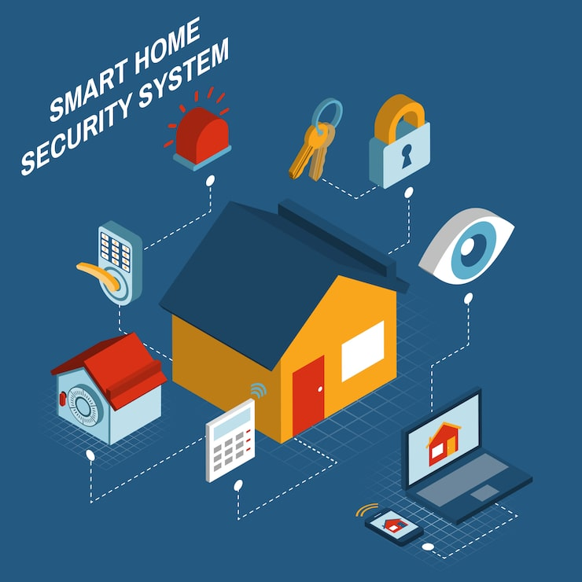
What is IoT-Based Smart Surveillance?
Intelligent security monitoring
Real-time data analysis
Automated threat detection
Reduced human intervention

Slide 3
How the System Works
IoT sensors and cameras
Network connectivity
AI-based processing
User dashboard & alerts

Slide 4
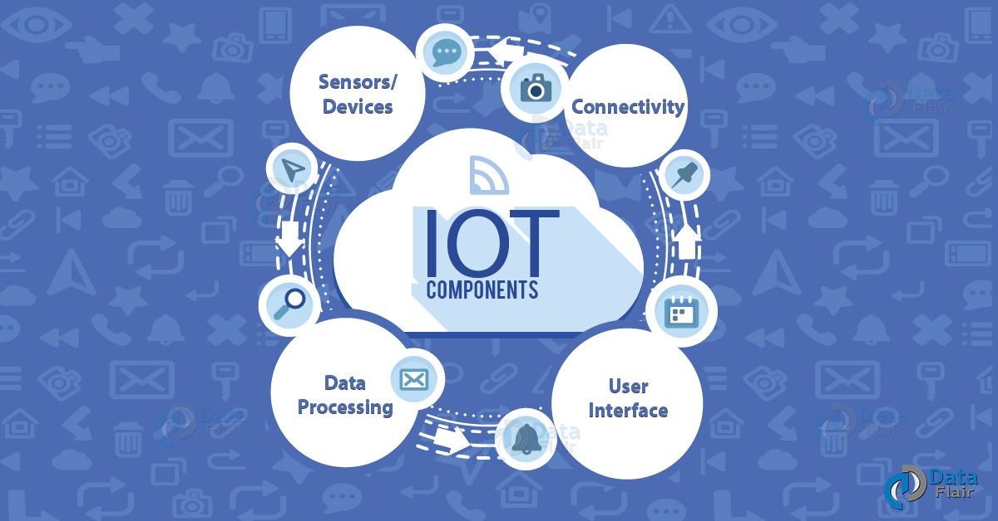
`
Main Components of the System
Smart cameras
IoT sensors
Cloud storage
AI analytics engine

Slide 5
Smart Surveillance Features
Real-time monitoring
Motion & intrusion detection
Face & object recognition
Remote access

Slide 6

Where It Is Used
Smart cities
Home security
Industries & warehouses
Educational institutions

Slide 7
Benefits of Smart Surveillance
Improved security
Reduced manpower
Scalable system
Cost-effective solution

Slide 8
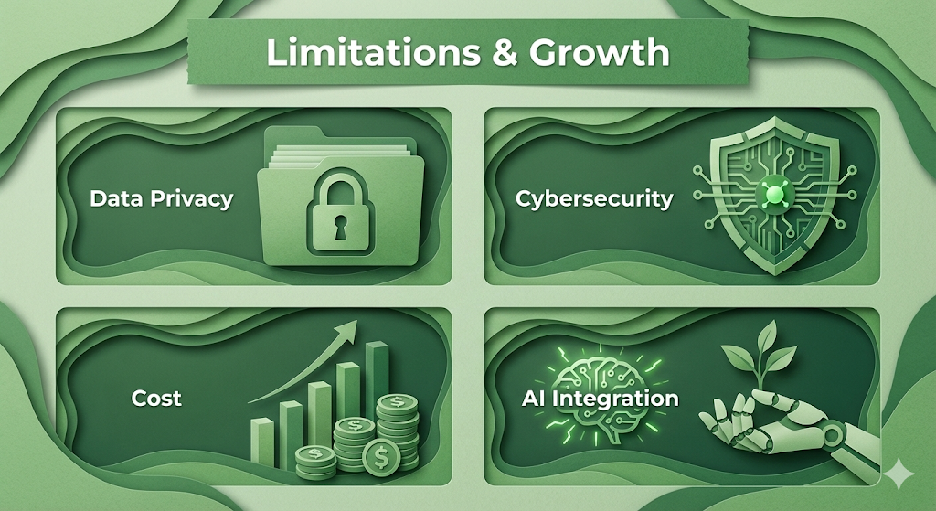
Limitations and Future Growth
Data privacy issues
Cybersecurity risks
High initial cost
Advanced AI integration

Slide 9
Final Thoughts
Future-ready surveillance
IoT-driven connectivity
AI-powered accuracy
Broad real-world impact

Slide 10
Thank You

